Slide 1
Phonics

Slide 2
Phonics at South Wingfield
Reception to Year 1 have daily phonics lessons
It is taught as a year group with extra interventions if needed.
Children are listened to read on a weekly basis
We follow the Letters and Sounds order
We have devised our own Phonics Programme
All children to take the Phonics Screening Check at the end of Year 1.

Slide 3
Vocabulary
Phoneme- the sound a letter(s) make
Grapheme- is the letters that make up a phoneme
Diagraph- two letters that make one sound e.g. oa in boat.
Trigraph- three letters that make one sound e.g. igh in light
Segmenting- breaking a word up into sounds.
Blending- putting the sounds together to read a word
Tricky words- words that cannot be easily decoded.
Fred Fingers- Used to sound out words.

Slide 4
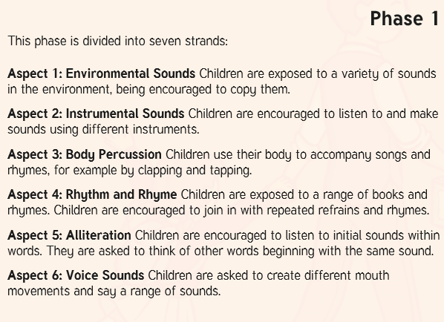

Slide 5
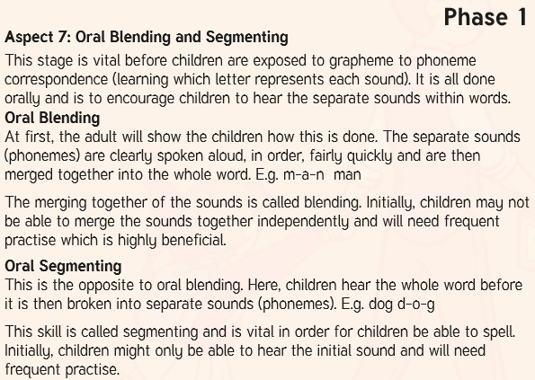

Slide 6
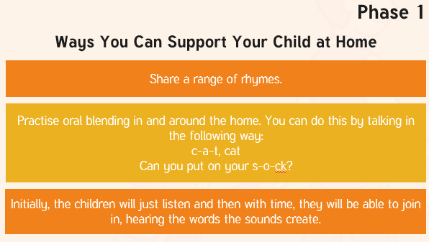

Slide 7
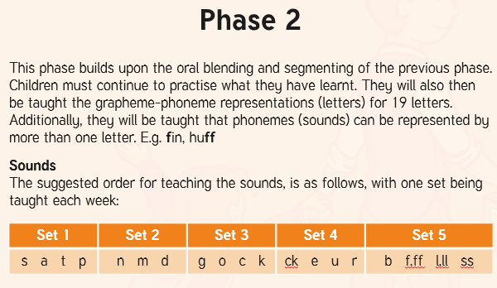

Slide 8
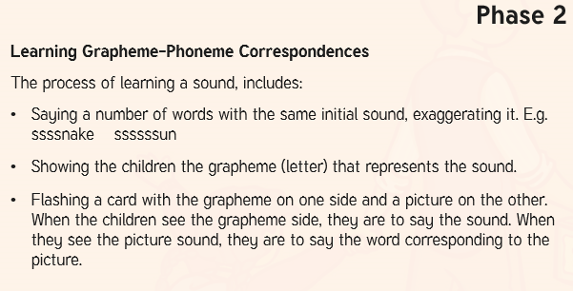

Slide 9
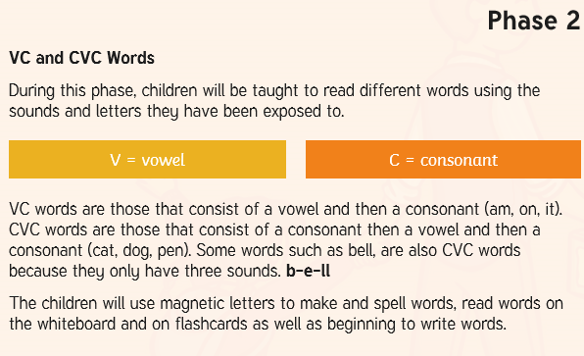

Slide 10
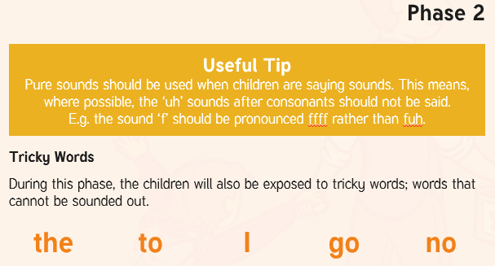

Slide 11
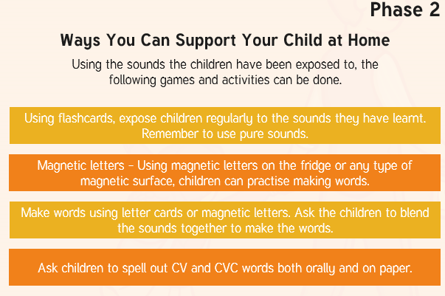

Slide 12
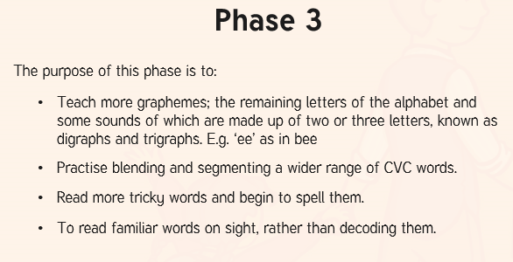

Slide 13
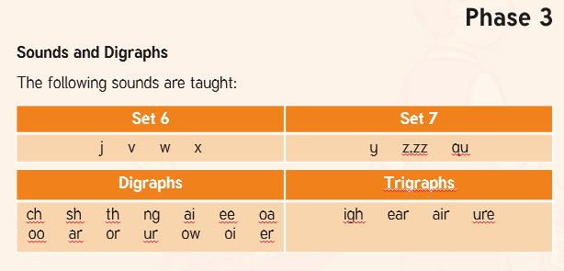

Slide 14
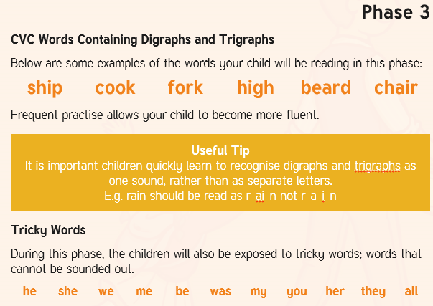

Slide 15
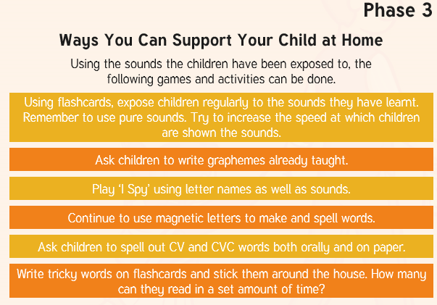

Slide 16
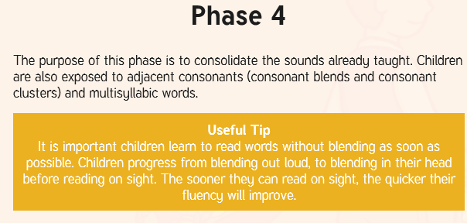
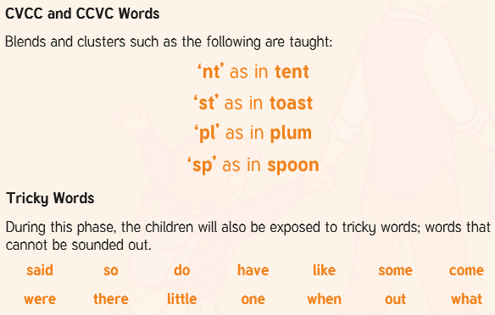

Slide 17
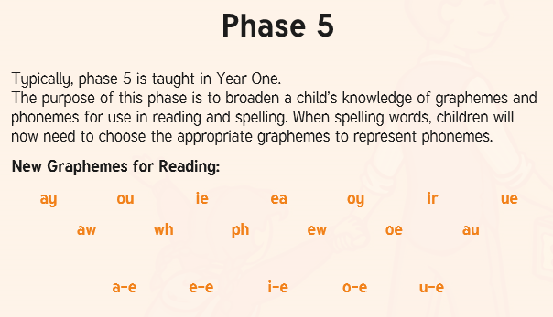

Slide 18
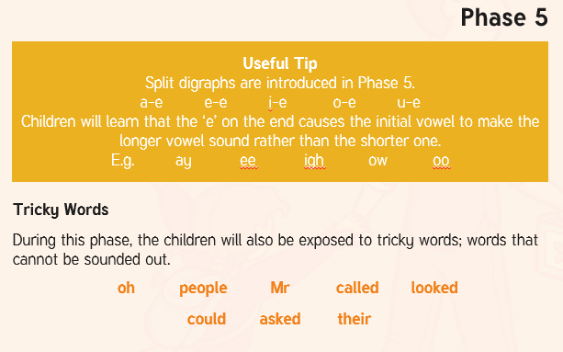

Slide 19
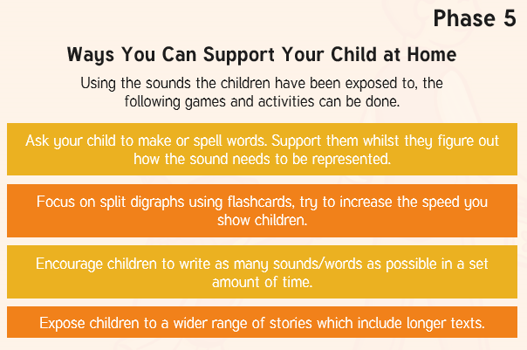

Slide 20


Slide 21


